Slide 1
End Organ Disease and Preventive Health Education
Notes:
We would like to teach you about the illnesses that may cause organ failure and lead to a person needing a transplant- liver, kidney, heart & lung. We will focus on what can be done to prevent disease and help you to stay healthy.

Slide 2
Overview
End organ disease: why people may need a transplant
What are the illnesses
How common are they
What are the causes/risk factors
*What can be done to reduce risks- points for education
Preventive health care/Screening exams
Notes:
This lesson will include a discussion of liver, kidney, heart and lung disease- outlining the illness, how common they are, and risk factors with a focus on what can be done to reduce these risks, screening exams and preventive health- i.e tips to live a healthy life. If we can teach people about this we should be able to make a positive change and reduce end organ disease and transplantation need.

Slide 3
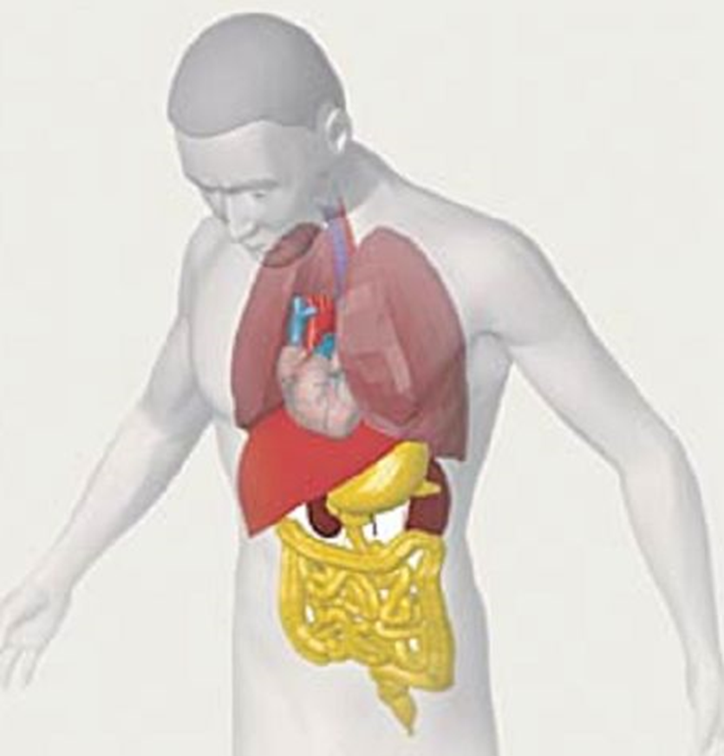
Transplant Waitlist Candidates
125, 722
103,112
14,237
898
4,043
1,438
251
Heart/Lung 45
Kidney/Pancreas 1698
Only a portion of people with end organ disease…….
Notes:
Many people are on the transplant waiting lists- 125,722 people in the United States were listed in April 2018 and this has been increasing a bit each year. The people on the waiting list represent only a portion of people with advanced disease as some people may not be eligible for transplant.

Slide 4
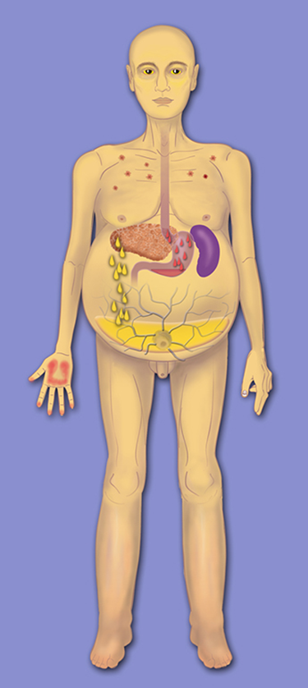
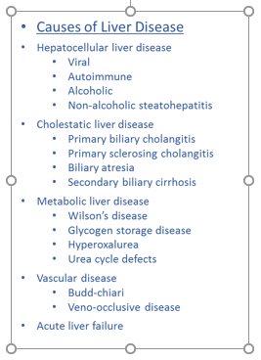
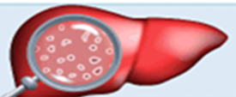
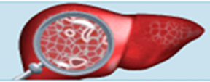
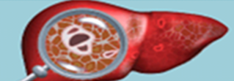
What is liver disease?
End Stage Liver Disease (ESLD)
hepatitis= liver inflammation
(= scarring)
STAGE 1
(mild fibrosis)
STAGE 2
(moderate fibrosis)
STAGE 3
(bridging fibrosis)
STAGE 4
(nodules, cirrhosis)
Notes:
The liver is in the right upper side of the belly (abdomen) and has a number of important jobs- it produces proteins involved in building muscle and blood clotting, makes bile that acts like a soap to digest fat, stores sugar and allows a person to be ok during times when they are not eating, cleanses the blood, and acts as a part of the immune system to fight infection. Most of liver disease results in inflammation of the liver- what we call hepatitis. When hepatitis ie inflammation goes on over time it leads to a build up of scar tissue in the liver. When the liver becomes very scarred we call it cirrhosis. People with cirrhosis may develop liver failure where there is not enough healthy liver to does its jobs or a high pressure around the liver from scarring that can result in water build-up in the body, bleeding and confusion from toxin build-up and are at an increased risk of developing a liver cancer. When this happens there are medications which can be used to treat some of the symptoms but the only cure is a transplant-replacing the damaged liver w/ either a deceased donor organ or partial liver from a live donor. There are many causes of liver disease listed here. All liver disease is NOT alcohol related and is NOT self inflicted.

Slide 5
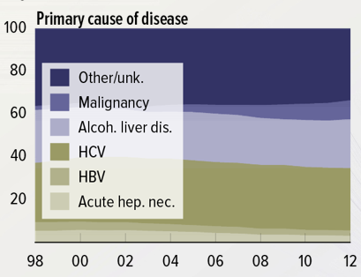
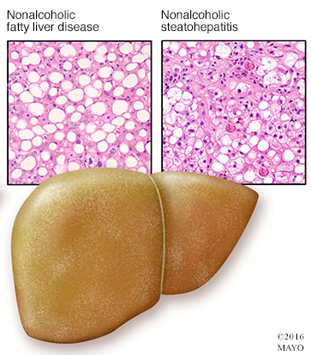
End Stage Liver Disease: Prevalence and Cause
About 4 million people have advanced liver disease in the USA
This is about 1.6% of people
NAFLD: Non-alcoholic fatty liver disease
Fat droplets build up in the liver and cause inflammation and scarring
15% of people in US in 2005 to 25% of people in 2015
NAFLD risk factors:
-high cholesterol
-heavy weight
-high sugar (diabetes)
-high blood pressure
%
Year
Notes:
How common is liver disease?
What are the causes?
There are about 4 million adults in the USA w/ liver disease
This is a graph that shows why people needed liver transplant from1998 to 2012. Hepatitis C virus was the number one cause. Thankfully, with awesome new treatments with over >90% of people being cured this is decreasing. Unfortunately, we are seeing an increase in NAFLD. NAFLD- the accumulation of fat droplets in the liver which may lead to hepatitis ie inflammation and scarring was noted in 15% of the US population is 2005 has now increased to approx. 25% of people in the US in 2015 and is associated with: high chol….

Slide 6
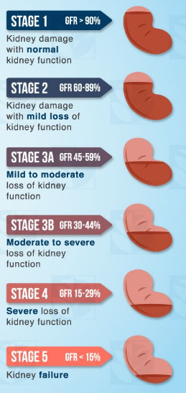
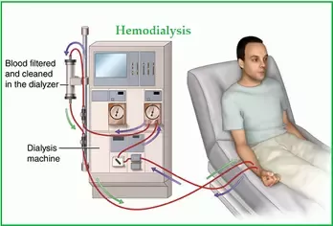
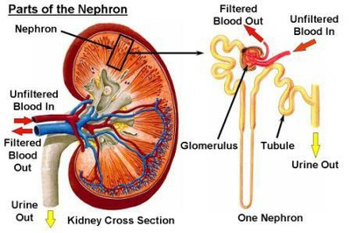
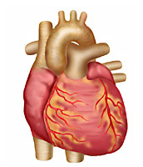
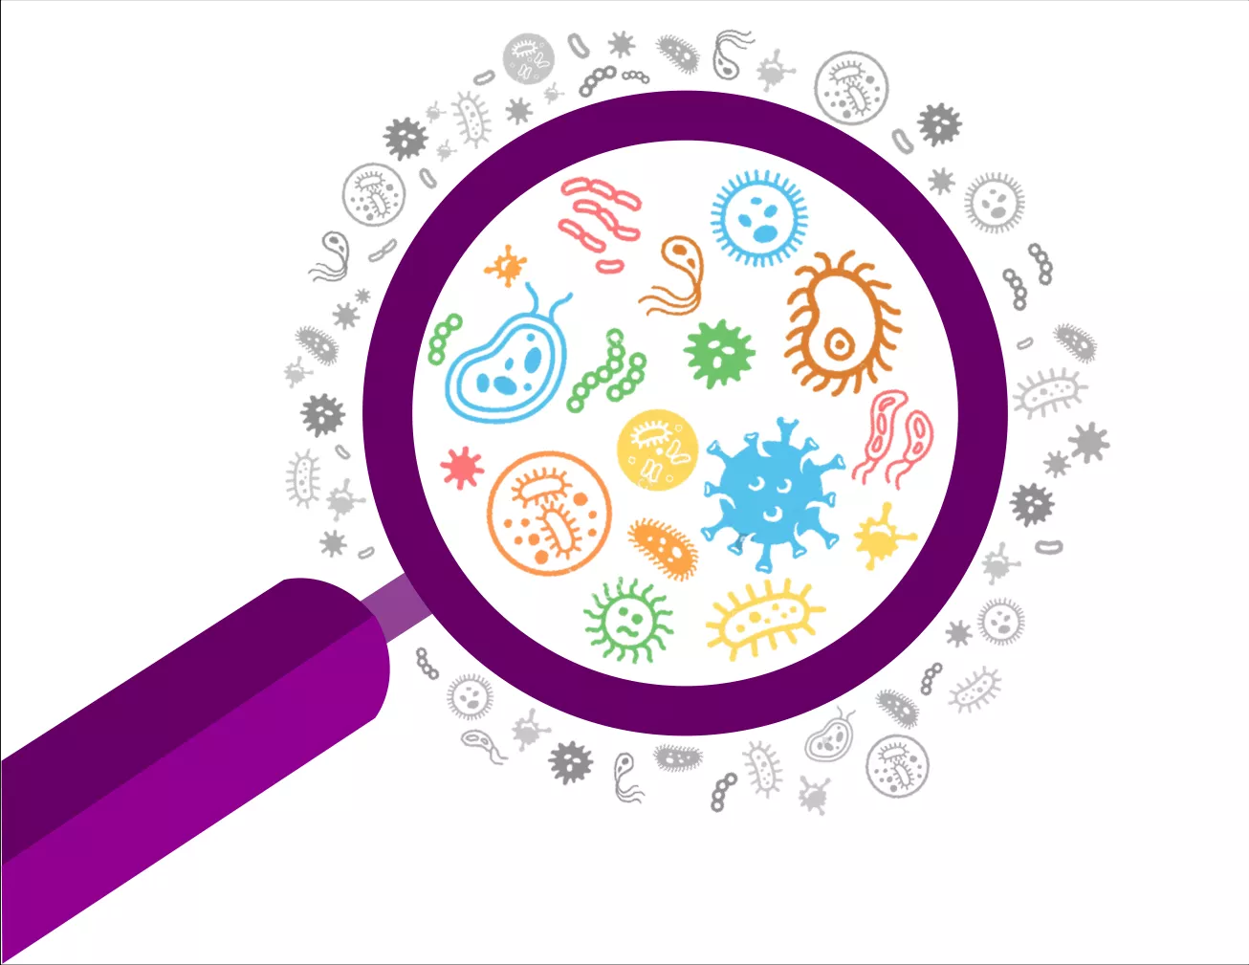
What is kidney disease?
End Stage Renal Disease (ESRD)
Renal Replacement Therapy
Quora
UNC kidney center
Villa Medica
Notes:
The kidneys are located just below the rib cage on each side of the spine- they filter the blood and produce urine to remove wastes and extra fluid. They keep the blood clean and healthy, including acid/base and electrolytes such as na, k, phos and they produce hormones which help keep a normal blood pressure, make red blood cells and keep bones strong. Most kidney disease affects the function of or produces scarring of the “nephrons” or tiny filters of the kidney. Kidney disease is staged on how good the kidney can still filter. When a person develops very advanced kidney failure they need a machine to do the work of the kidneys -ie dialysis to survive. Though these machines are available these people are still very sick and often die from heart disease or infections associated with kidney failure. Kidney transplant can save someone’s life.

Slide 7
End Stage Renal (kidney) Disease: Prevalence and Cause
About 5 million people have advanced kidney disease in the USA
This about 2.0% of people
Kidney disease is the 9th most common cause of death
%
Notes:
About 5 million people in the USA have kidney disease. Kidney disease is the 9th most common cause of death. Most kidney transplants are done for kidney disease related to diabetes and high blood pressure.

Slide 8
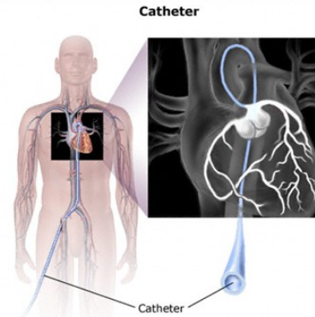
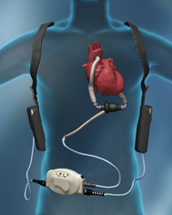
What is heart disease?
Dawn Charman, M.Ed, R.T.
Creative Diagnostics
MyLVAD
Notes:
The heart is located just left to the center of the chest and serves as the major pump in the body to provide oxygen risk blood to nourish all the vitals organs/tissue of the body. Heart disease comes in many forms. Coronary artery disease is when the arteries supplying blood to the heart itself become blocked and a heart attack may happen whereby there is no blood flow to that part of the heart muscle and it dies resulting in a decreased ability of the heart to maintain its pump function. There are other diseases which may cause a decrease in heart pump function what we call cardiomyopathy including infections, toxins/medications, and genetic disorders. There may be illness of the heart valves or conduction system of the heart causing abnormal rhythms and potentially death. Medications may be used to reduce plaque in the arteries, improve heart function and control abnormal heart rhythms or catheter based therapies or surgery to open up blockages and repair valves or instill pacemakers However, when the heart fails w/ inability to adequately maintain its pump function the only cure is consideration of a surgically implanted pump device and ultimate transplant. Risk factors for heart disease include: - smoking, high cholesterol, diabetes, high blood pressure, being overweight and not exercising.

Slide 9
End stage heart disease: Prevalence and Cause
About 28.4 million people have advanced heart disease in the USA
This is about 12% of people
Number of deaths: 633,842
Heart disease is the number 1 cause of death
%
Notes:
Heart disease is the number one killer in the US. 28.4mil adults in the USA have heart disease. The majority of heart transplants have been performed for coronary artery disease (blockages in the blood vessels of the heart) or cardiomyopathy (problems with the heart’s pumping)

Slide 10
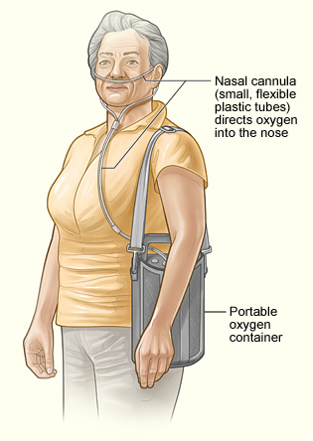
What is lung disease?
Types of Lung Disease:
Airway Disease
Lung Tissue Disease
Pulmonary Circulation Disease
Notes:
The lungs are located in chest cavity. They allow for gas exchange- ie oxygen from incoming air enters the blood and carbon dioxide a waste gas leaves the blood. A reduction in lung function means a reduction in the lungs ability to exchange gas. There are 3 categories of lung disease- airway disease, lung tissue disease, and pulmonary circulation disease. Asthma refers to airway inflammation and spasm. Emphysema is a destruction of the alveoli or small air sacs of the lung resulting in impaired gas exchange. People may use oxygen tanks to overcome some lung disease however as it gets worse there oxygen levels get worse and they feel like they can’t catch their breath (low oxygen levels) and they get infections like pneumonia and transplantation may be needed for survival.

Slide 11
End Stage Lung disease: Prevalence and Cause
About 14 million people have advanced lung disease in the USA
This is about 5% of people
Group A, obstructive lung disease
Group B, pulmonary vascular disease
Group C, cystic fibrosis and immunodeficiency disorders;
Group D, restrictive lung disease
%
Notes:
In the US 9.3mil and 3.5mil people have been dx’d w/ chronic bronchitis and emphysema respectively which are obstructive lung diseases and account for approx. ½ of all lung transplants. Obstructive- CB and EM and Restrictive lung disease- those affecting stiffness of lung tissue such as pulmonary fibrosis account for the majority of lung transplants. A lesser number of lung transplants are performed for CF, vascular disease.

Slide 12
Tobacco: A Killer- Major Danger for Young people
1,300 people die each day due to smoking in the USA
Smokers die 10 years earlier than nonsmokers
If smoking continues at the current rate among U.S. youth, 5.6 million of today’s Americans younger than 18 years of age are expected to die early from a smoking-related illness. This is one in every 13 Americans aged 17 years or younger who are alive today.
Notes:
Tobacco use- resulting in lung disease, heart disease and malignancy (cancer) is a major killer and a significant risk to our youth-

Slide 13
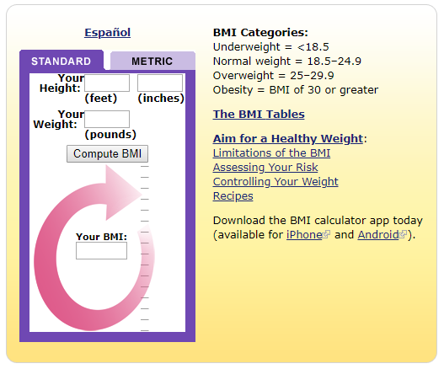
Obesity- An unhealthy weight
Body Mass Index: BMI

Slide 14
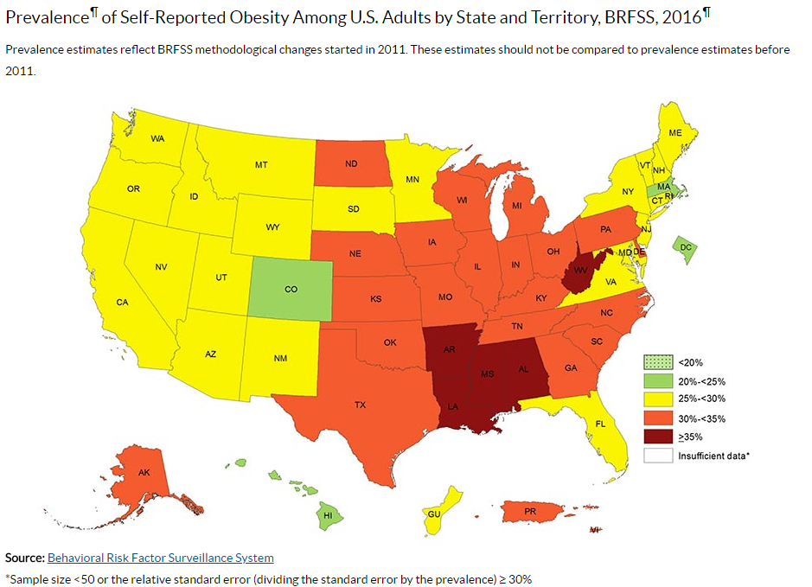
A Common Cause of disease- Obesity and Metabolic Syndrome
Notes:
Much end organ disease is related to obesity and the metabolic syndrome. Obesity has gotten out of control. Over 20% of the US population is obese. In some regions this reaches >35%. In 2016, 25-30% of people living in Connecticut were obese.

Slide 15
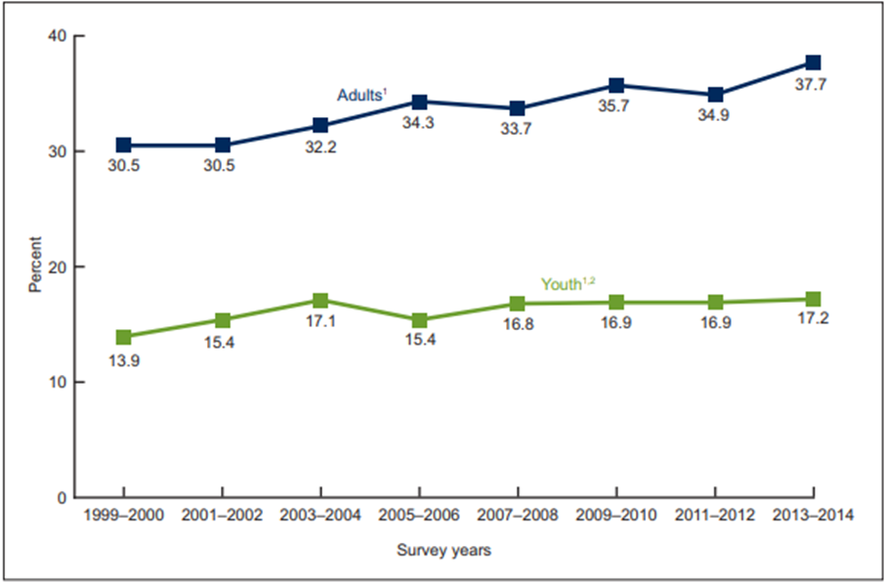
Obesity in youth
Notes:
Over time people in the United States have been getting “fatter” and this includes young people (the blue line is adults and the green line is kids)- caused mostly by poor dietary choices and inactivity.

Slide 16
Metabolic Syndrome
Bad cholesterol
Is high
Good cholesterol is low
High sugar
Heavy weight
Notes:
Metabolic syndrome or syndrome “X” is diagnosed when a person meets 3 of the following criteria- BP…
Metabolic syndrome is as I said a common thread in end organ disease.

Slide 17
Prevention is Key
Screening tests:
Go to the doctor for regular check-ups
Keep a healthy weight- Diet, Exercise
Measure Blood pressure & oxygen levels
Have you sugar (glucose) checked
Have your cholesterol checked
Check how kidneys are working with urine test
Don’t drink alcohol
Say no to drugs!
Don’t smoke!
Notes:
Important part of talk
How to prevent
Healthy eating
Exercise/Activity- reduction of “screen” time
Avoid toxic exposure, tobacco, etoh and drugs
Check-up, Accessing health care

Slide 18
Work with your friends to stay healthy
Use “apps” to:
Eat better
Track your exercise
Competition is fun!

