Slide 1
Recycle Yourself
Save lives through organ, eye, and tissue donation!
Notes:
Introduce yourself!
Who are you? What’s your job? Why are you here?
If your job is related to donation/transplantation, how did you choose your job?
If you are a volunteer, what motivates you to educate people about donation? (don’t tell your whole story yet)
As I go through my presentation, raise your hand if you have a question! I’ll do my best to answer (but I am not a health professional).

Slide 2
Donate Life CT registers donors & educates the public about donation. We work with…
Organ, eye, and tissue recovery professionals
Notes:
How many of you have heard of Donate Life Connecticut (raise your hands)?
Donate Life Connecticut is a small non-profit organization which does incredibly important work! We provide free educational programs to schools, community, businesses, faith centers and media around the state of Connecticut.
Many great partners help us save lives:
Connecticut eye and tissue procurement organizations: New England Donor Services procure the cornea and tissues, then work with several organizations in the NE area.
These are the medical professionals who oversee the actual donation process.
Transplant centers: Only two hospitals in the state perform transplant surgeries, and not all kinds of transplants are done in Connecticut. Yale University and Hartford Hospital.
Organs that can be transplanted in CT are: kidney, liver, bone marrow, cornea and tissue. Otherwise, if you need a heart, brain, lung, etc. transplant, the patient would need to travel outside of CT.
DMV: when you turn 16, you’ll be asked by our partners at DMV whether you want to be a donor. 43% of Connecticut residents with a driver’s license say YES to donation. This number is far below other states.

Slide 3
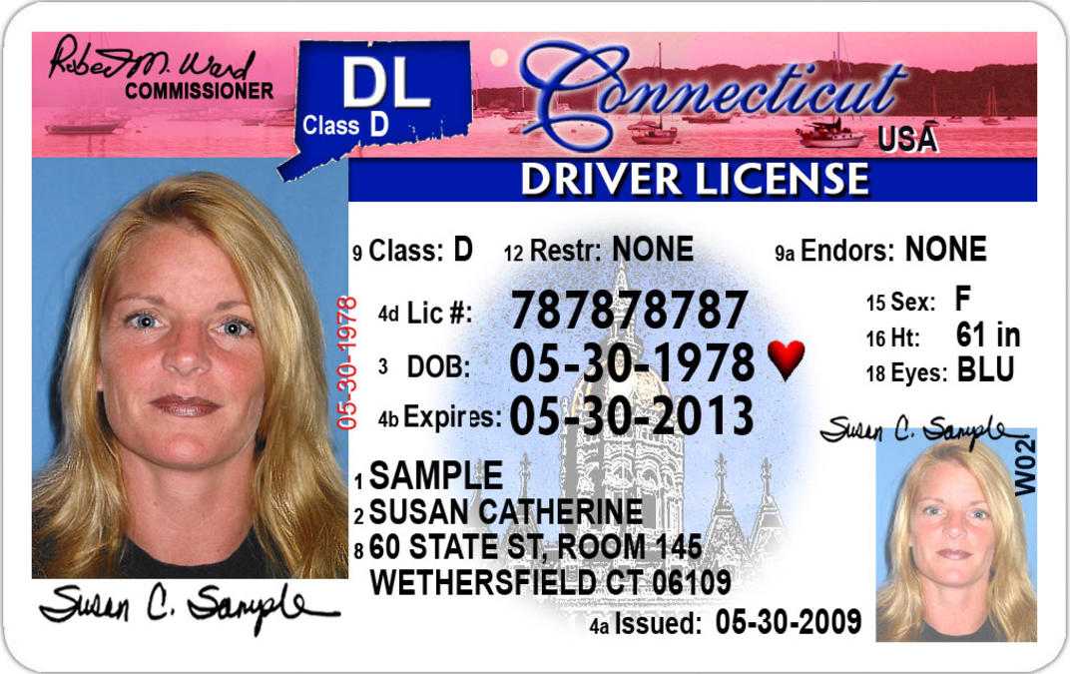
Do you have a red on your license?
After I die, I wish to donate organs, eyes, and/or tissues to save someone’s life, restore someone’s vision, and/or restore someone’s mobility.
Notes:
It’s partly thanks to our amazing partnership with the DMV that I’m here today! How many of you already have a driver’s permit, license or ID?
How many of you have a red heart?
If you haven’t been, then you should know that when you go to DMV to get your permit, license, or ID, they will ask you (and the form you fill out will too) “Do you wish to register as an organ, eye and tissue donor?”
Saying yes means you willing to donate your tissue and organs after you die.
After I die, I wish to donate…

Slide 4
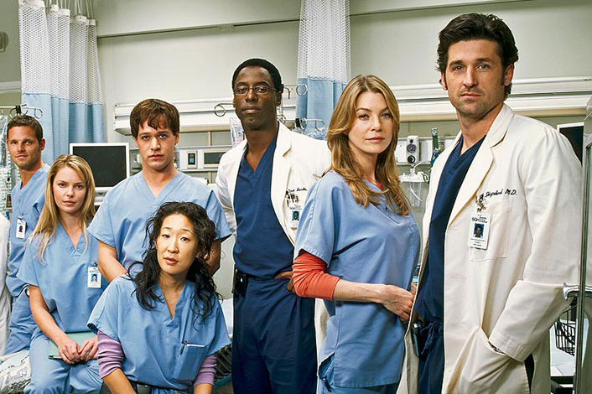
Why Don’t People Register?
Fears, Myths, and Misinformation
Hollywood and TV
Concern over medical care
Religious beliefs about donation
Don’t think they are eligible
Don’t want to think about death
Don’t know how to sign up
Notes:
Although people in our region often register, they do not always talk to their families about donation. Some people do not want to register at all. Why do you think that is? How do you think people usually learn about donation (if they are not lucky enough to have us visit their classroom?)
At Donate Life Connecticut we hear a lot of interesting reasons… and sadly, most are based in fears, myths, and incorrect information! It is very common for people to believe what they see in movies or on TV.
*Click through each bullet point
Points for further discussion:
Why does Hollywood portray donation so incorrectly?
Doctors are not involved in the donation process. They do everything they can to save your life, and do not know (or care) if you are a registered donor!
All major religions in the US support donation for the purpose of a life-saving transplant.
Age or past medical issues may not prevent your ability to donate.
You don’t have to wait to go to DMV to register. You can become a registered donor at the age 16 with parent consent at registerme.org or with a paper form.
Other Facts you can discuss:
Donation costs your family nothing.
Buying or selling organs is a federal crime.
Donation does not interfere with funeral arrangements.

Slide 5
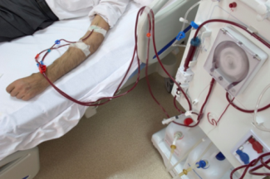
The Need for Organ Donors
Every 10 minutes, someone is added to the waiting list.
On average, 20 people die each day while waiting for a transplant.
Notes:
Ask students to raise their hand if they know someone impacted by donation / transplant. If they are willing, invite them to share their story.
The need for healthy, transplantable organs has reached crisis levels throughout the United States. As you can see, since the 90’s, the number of deceased and living donors has stayed somewhat constant, whereas the number of people needing an organ transplant has risen dramatically. There are MANY waiting for an organ transplant, but comparatively few donors.
This data shows ONLY the number of people on the waiting list for organ transplants.
This data does NOT reflect the hundreds of thousands more people who could benefit from tissue and cornea transplants.
Neither does it reflect those WAITING to be placed on the waiting list!
Based on UNOS numbers
1995 2000 2005 2010 2015 Living Donors 3496 5957 6904 6562 5992 Deceased Donors 5363 5985 7593 7943 9079 Transplants 19396 23266 28118 28662 30973 Waiting List 41203 74078 90526 110375 122071

Slide 6
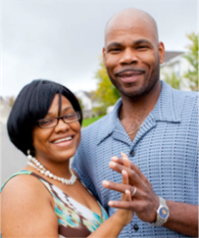
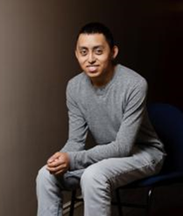
80% of everyone waiting needs
a kidney
Americans are increasingly at risk for conditions which eventually lead to kidney failure:
Type II Diabetes*
High Blood Pressure*
Hispanic, African, Asian, and Native Americans are 3x more likely than Caucasians to suffer these conditions.
* Can be prevented or delayed by staying at a healthy weight, eating well and getting exercise.
Notes:
Alarmingly, there is even more of a need with some ethnic groups, due to a high incidence of conditions such as high blood pressure or diabetes, both of which can lead to the need for a kidney transplant.
African, Native, Asian, and Hispanic Americans are 3 times more likely than Caucasians to suffer from end-stage kidney disease, often as the result of high blood pressure and other conditions that can damage the kidneys.
Genetics and lifestyle choices contribute to the higher rates of these acquired conditions.
Possible discussion question (recommended for advanced classes / mature groups):
It’s important to note that while communities of color make up 56% of the waiting list – a disproportionately high percent! - they are in fact less likely to register as donors. (AKA more likely to need a transplant, but less likely to donate). Why do you think this may be?
Cultural taboos: for example, talking about death is not permitted
Language barriers
Socioeconomic factors contributing to poor lifestyle & health choices
Fear or mistrust of medical system & doctors

Slide 7
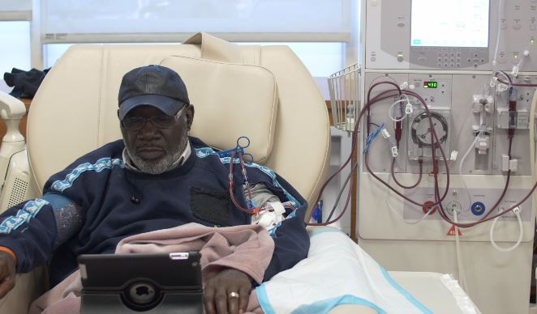
What is it like waiting?
Doctors refer sick patient to a transplant center.
A committee of doctors, surgeons, and hospital staff decide whether a patient is a candidate for transplant.
A transplant candidate is added to the national waiting list.
People stay on the national waiting list for days, months, or even years.
The Waiting List
Alysia’s Story
Notes:
Discussion prompt:
How do you imagine it must feel, waiting and hoping you’ll get your lifesaving transplant? Ask students for adjectives (scary, nervewracking, etc.)
Playing the “Alysia’s story” video is optional; it is 1 minute, 32 seconds long.
Being placed on the waiting list is not automatic. Because there are so few organs available, professionals must be sure that an individual is stable – emotionally, physically and financially – in order to ensure that they can take care of their new organ for the rest of their life.
Playing the “How the national organ transplant waiting list works” video is optional, it is 1 minute, 35 seconds long.
Frequently Asked Questions
What determines whether people get on the list?
This decision is based on the status of the patient’s health, his or her medical and social history, and the expectation of their stability after the transplant takes place.
How long do people stay on the waiting list?
Those on the national waiting list may wait days, months, or even years. Many medical and logistical criteria impact the time an individual spends on the waiting list, including: • Blood type and size of organ needed • Distance between donor and recipient • Medical urgency • Immune-system matching UNOS provides detailed statistics on the waiting list.

Slide 8
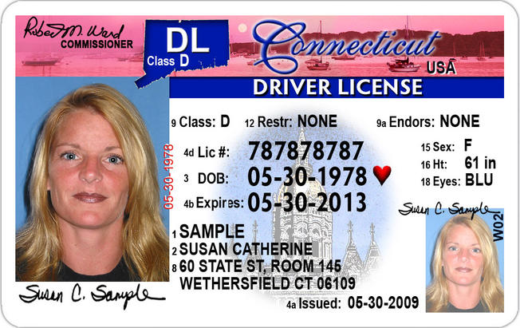
Local Heroes
Over a million Connecticut residents are registered donors
≈ 30,546 Connecticut residents died in 2016
To date, approximately 1,200 Connecticut residents are waiting
391
cornea donors
582
tissue donors
78 organ donors = 263 organ transplants
Notes:
How many lives are impacted by donation in Connecticut?
Cornea transplants are transplants made possible by donors in Connecticut, not necessarily occurring in Connecticut. Note that sometimes corneas are donated and used for research.
Before revealing the number of organ donors, ask the students to guess how many they think there were, given how many people register.
Nationally, less than 1% of the general population are eligible to be organ donors, while being a tissue/cornea donors is much more common.
Ask students, why are these numbers so low?

Slide 9
True or False:
Organ donation is very common.
False. Not everyone who dies can donate organs, because they must pass away under very specific circumstances.
Notes:
Move to next slide, to explain what those special circumstances are.

Slide 10
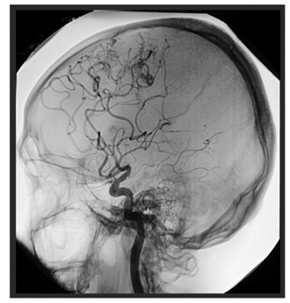
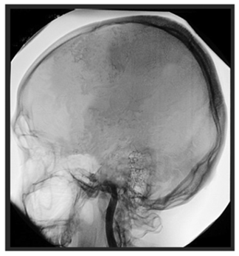
3 Criteria for Organ Donors
Donor died in a hospital.
Donor was placed on mechanical ventilator prior to death.
Blood and oxygen continue to flow through the vital organs.
Severe trauma caused the brain to swell, resulting in brain death.
Electricity, blood and oxygen irreversibly cease to flow.
Notes:
Three rare circumstances must come together in order for someone to be considered a potential organ donor:
Upper image: blood flow inside a normal, active brain; electricity, blood and oxygen continue to flow.
Lower image: brain death. No activity.
Brain death is usually the result of a severe trauma which causes brain tissues to swell. Some examples:
Trauma: for example, a severe head injury during a motor vehicle accident.
Cerebrovascular injury: massive bleeding caused by a stroke or ruptured aneurysm.
Anoxia: loss of oxygen to the brain caused by drowning, a heart attack or drug overdose.
Uncontrollable growth of a brain tumor that causes permanent loss of blood flow and oxygen to the brain.
When the brain is injured, it responds in much the same way as an injury like a twisted ankle: it swells. Unlike the
muscles and tissues of the ankle, however, the brain is in a confined space – the skull – and has no room to swell.
As the brain swells inside the skull, it pushes downward toward the brain stem blocking all upward flow of blood.
Depending on the type of injury, this may happen within minutes or over a period of days. Even while the heart is still
beating and supplying blood to the rest of the body, blood that carries oxygen cannot reach the brain or the brain
stem, which controls heart rate and breathing. The result is that the brain, and therefore the person, dies.
Because brain death is not a common occurrence, viable organ donors are rare.
Brain death can be a confusing concept, because a brain dead person on a ventilator can feel warm to the touch
and can look “alive.” Their heart beats, and it appears as though they are breathing. Why is this? Because the
individual was placed on a mechanical ventilator prior to death, the ventilator is pushing air into the lungs, making
the person’s chest rise and fall, allowing the heart to continue to beat. However, once the mechanical ventilator is
removed, the heart will stop due to lack of oxygen.
- See the Recycle Yourself: A Guide to Organ, Eye and Tissue Donation for more information.

Slide 11
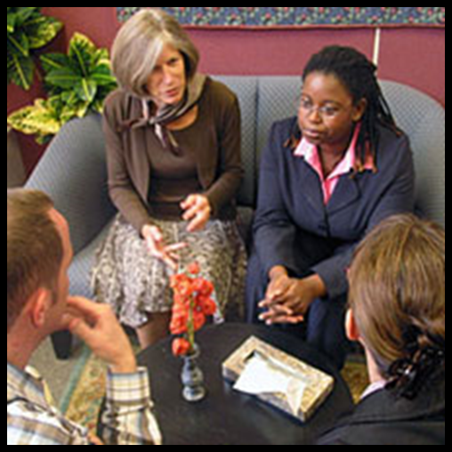
Next Steps
If someone CAN be an organ donor…
A separate team comes in
The registry is checked
The family is approached
If under 18, the family will be asked to authorize donation
TALK TO YOUR FAMILY TODAY!
Notes:
If someone is a registered donor and they are over the age of 18, “the D” or the registration is honored.
It is critical that you discuss your decision with your family. Whether or not you are registered, a recovery coordinator will always speak to your next of kin regarding authorization!
*FAQ: If I am registered in a different state, will the RC know that I’m a donor?
Answer: Every state has its own registry. The Recovery Coordinator would contact the registry of the state you are from, assuming this can be determined. You should always register in the state you live in.

Slide 12
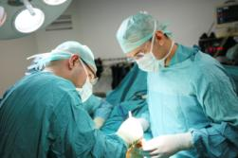
Organ Recovery
The recovery surgery takes place in an operating room, in the same sterile and careful way as in any surgery.
There are no costs to the family for the donation process.
Being an organ or tissue donor does not interfere with funeral arrangements.
Notes:
Read Slide
Donors are treated respectfully throughout the process, and donation does not cause any disfigurement.
Recovery professionals and funeral homes perform routine reconstruction and preservation.

Slide 13
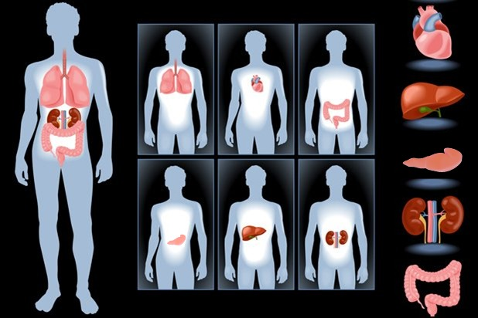
Which Organs Can be Donated?
Notes:
Discussion suggestions:
Have students identify the organs.
Ask students why they think someone would need a heart transplant (or lung, pancreas, liver, kidney or intestine…).
If you are a recipient, this is a great time to talk about what brought you to need a transplant.
See Recycle Yourself: A Guide to Organ, Eye and Tissue Donation to learn more about common reasons for transplant, per organ.
FYI – students will almost always cite “alcoholism” as a reason people need liver transplants. This is an important myth to diffuse.
First of all, leading causes for needing a liver transplant are non-fatty liver disease (cirrhosis which develops due to poor diet and lack of exercise) and Hepatitis.
Alcoholics in need of a new liver are by no means automatically placed on the waiting list. They must demonstrate sobriety for over a year before they can even be considered a transplant candidate! There are so few livers available to save lives that doctors must ensure that transplant candidates will take good care of this precious gift. Needing a transplant and being officially placed on the waiting list are not automatically mutual.

Slide 14
One organ donor can save up to 8 lives

Slide 15
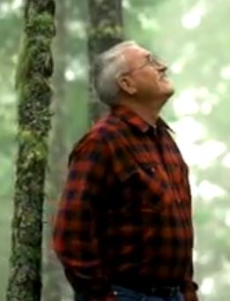
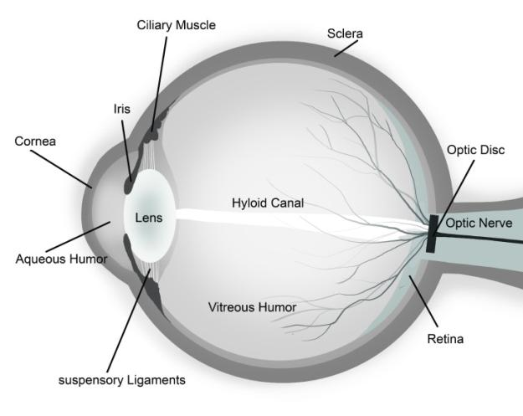
What is a Cornea?
John’s Story
Notes:
Corneal transplant is the most common of all transplants performed! In fact, ophthalmologists perform over 46,000 corneal transplants a year in the United States.
The cornea is the clear surface at the front of the eye. It is the main focusing element of the eye, containing five microscopically thin layers. It protects the eye from dust and germs, and is responsible for vision focus (it is not the colorful iris nor the black pupil, and has nothing to do with eye color).
Optional: “John’s Story” video is 53 seconds long.

Slide 16
True or False:
Donated corneas can restore sight to the blind.
True. When the cornea is damaged due to injury, disease, infection or a hereditary condition, corneal transplant surgery may be an option.
Notes:
Why might someone need a corneal transplant?
Hereditary conditions. Certain medical conditions make the cornea very thin or cloudy, or cause other problems that can only be treated by replacing the cornea. Examples: fuchs dystophy, corneal distrophy, glaucoma.
Injury to the eye. For example, chemical burns or exposure; corneal abrasions.
Disease / infection. With keratoconus, for example, the shape of the cornea slowly changes from the normal round shape to a cone.
Advances in pharmacology, medical instruments and surgical techniques have made the surgery incredibly effective– research made possible through tissue donation. Today, cornea transplant surgery has a success rate that exceeds 95%.
When someone in Oregon or SW Washington passes away, and they are found to be a registered donor, Lions Vision Gift handles the possible cornea donation. They determine a donor’s eligibility based on medical records and interviews with family members. The questions in the interviews are similar to the kinds of questions asked before you donate blood. Corneas are typically recovered within 18 hours of someone’s death.

Slide 17
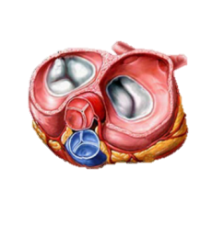
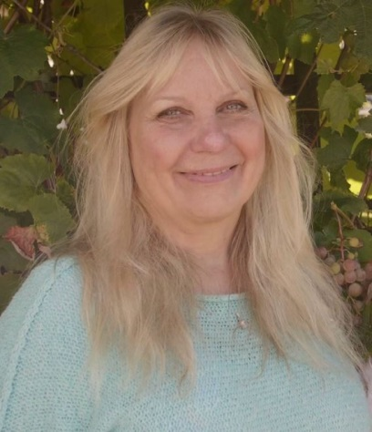
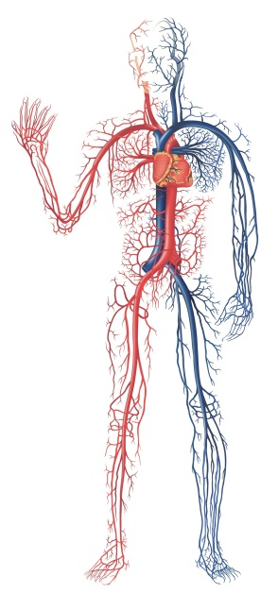
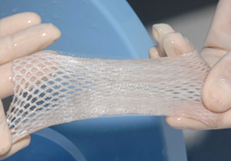
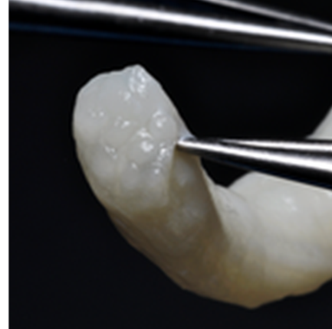
Which tissues can be donated?
Jan’s Story
Notes:
Optional: Jan’s Story, 1 minute, 28 seconds
Tissues, clockwise from top left: bone, heart valve, tendons and ligaments (ACL), veins/arteries (far right), nerve, skin
Have students guess at what each tissue is, and have them suggest what someone might need each donated tissue for. Examples, and more details below.
Bone: Bones can be recovered and processed for many uses. Bone tumors which would have required amputation in the past are now replaceable due to donated bone. Bone can also be used in spinal surgeries, hip replacements, knee replacement, and dental surgery.
Heart valves: Babies may be born with heart defects and may require a donated heart valve to survive.
The picture of the leg represents tendons/ligaments and cartilage. The ACL (pictured) can be used for athletes who have torn theirs. (ACLs can also be repaired in other ways; using a donated ACL is just one of the ways). Other tendons may be used for reconstruction of rotator cuff, knee ligaments, and Achilles Tendon repair. Cartilage (also pictured) can be donated and used to help repair joints.
Veins/Arteries: repair of veins and arteries to improve circulation if there is disease, injury, or blockage
Nerves: Provides a pathway for nerves to reconnect due to injury or surgery. Restores peripheral nerve, muscle, organ function. Restores sensory feeling!
Skin: donated skin (taken unobtrusively from a donor, only the thickness of a piece of paper) is used as a biological bandage, preventing infection and allowing them to heal until their own skin can grow back. Donated skin is removed from areas usually hidden by clothing (back, back/front of legs, buttocks, and tops of thighs; sometimes the front of the trunk and the back of the arms). Donation of the skin does NOT interfere with funeral viewing arrangements.

Slide 18
One tissue and eye donor
can save or enhance over 75 lives

Slide 19
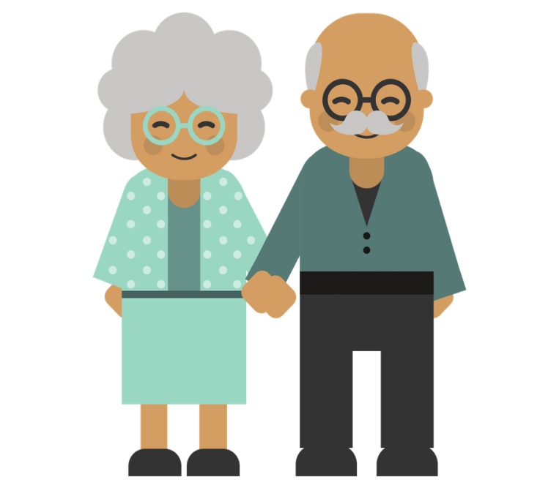
True or False:
Grandma and Grandpa
can be donors.
True. No one should rule themselves out due to age, health, or medical conditions! Additionally, the criteria required for organ donation do not apply to tissue and eye donation.
Notes:
Answer: True!
First off, there is no knowing if someone may die in the right circumstances, and if so, they will be evaluated on a case-by-case basis as to whether or not they can be an organ donor. Additionally, they can likely still save lives through TISSUE or EYE donation.
Why is this?
Essentially, the criteria required for organ donation do not apply to tissue and eye donation.
The person does not have to pass away in a hospital – could be hospice, home, hospital, etc.
The person can pass away of natural causes.
Even having certain diseases – cancer, Lyme disease, etc. – may not prevent you from being able to donate tissue or eyes!
Many tissues (cornea, cartilage, etc.) are avascular, meaning no blood runs through them, so they are not impacted by some diseases.
Regardless, community tissue services work closely with the potential a donor’s next-of-kin and doctors to do a thorough evaluation. A full medical and social history is conducted (several times in fact) to ensure that the donor’s tissues are safe for transplant.

Slide 20
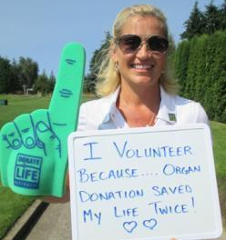
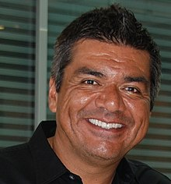
Life After Transplant
Managing rejection
Healthy lifestyle
More LIFE
Justice’s Story
Notes:
Transplant is not a cure, for many it provide a new chance at life. Although there are still many obstacles and many things you have to do keep yourself healthy. There are many doctor visits and medication you have to take to maintain your health.
Transplant recipients always face the possibility of rejection. When an organ is transplanted, the recipient’s immune system sees this organ as ‘foreign’ and will begin to attack the new organ. To combat this problem, anti-rejection drugs have been developed. These suppress the recipient’s immune system so that it is less likely to attack the transplanted organ. Organ transplant recipients need to take anti-rejection drugs for the rest of their lives (most of the time).
Tissue transplants also face a possibility of rejection– though less common. Cornea recipients are prescribed eye drops that help the body accept the new graft, as well as other medications to help control infection, discomfort, and swelling. Most other tissues are processed in a way that removes extra cellular markers that could result in an immunologic reaction.
Despite this, most people believe this is a small price to pay for procedures that save lives, restore sight, restore function, and free people from daily hospital visits. For many, transplantation is the best treatment option.
Most people who receive transplants are able to go back to living a healthy, active life… like these people!
Celebrities:
Top Middle Left: Sarah Hyland – kidney recipient
Top Right: Selena Gomez– kidney recipient
Bottom Left: Laurie Hernandez – tissue recipient
Bottom Middle Left: Mandy Patinkin (Inigo Montoya from the Princess Bride) – cornea recipient
Bottom Middle Right: George Lopez – kidney recipient
Bottom right: Steve Jobs – liver recipient
Top Left is Justice Williams. He is a high-school aged liver recipient who goes to Forest Grove High School. His video is about 1.5 minutes long. If you are not an organ recipient and want to share his story, you are welcome to. **Show video

Slide 21
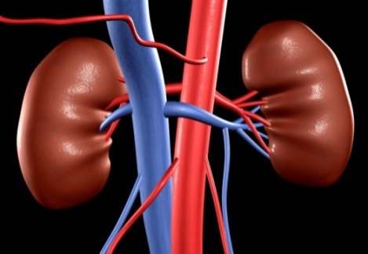
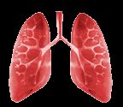
What can you donate while living?
A kidney
A portion of your liver
Very small portion of lung called a lobe
Blood and bone marrow
You can donate a kidney to save the life of anyone who matches your blood and tissue type – recipients don’t have to be a blood relative!
Paired and chain donation
How safe is it for the donor?
Living donation has nothing to do with registering as a deceased donor.
In the US, you must be at least 18 to consider living kidney donation.
Notes:
Please note that this Power Point is designed for a high school audience. The goal is simply to raise awareness of living kidney donation, not promote it.
If you’d like to learn more about living kidney donation, see the Recycle Yourself: A Guide to Organ, Eye and Tissue Donation curriculum.

Slide 22
Pop Quiz
How many people’s lives can be saved or enhanced by tissue and/or cornea donation?
Do you know if your family members are registered donors?
What is one new thing you learned today?
Notes:
OPTIONAL SLIDE
Ask students to: Write down on the back of your evaluation one thing you learned today
#1-over 75

Slide 23
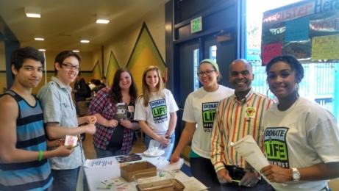
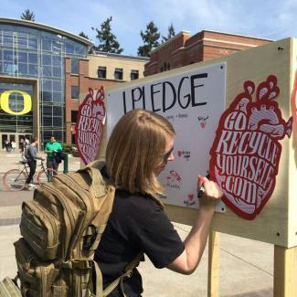
What Can You Do Today?
Eat right and exercise!
Especially if your background puts you at high
risk for Type II Diabetes or High Blood Pressure!
Register!
Online (registerme.org)
Paper form
Say “YES” to donation at DMV
On iPhone Health App (at age 18)
Talk to your family!
Student projects!
Notes:
Brainstorm ideas for school projects with the students, perhaps for extra credit opportunities.

Slide 24
Evan’s Story
Notes:
Please show if you have time. This will close the presentation. Click on the picture to play the video.
This video is 3 minutes, 30 seconds

Slide 25
Learn more and register…
Donatelifect.org
Registerme.org
www.DonateLifeCT.org
www.donevidanw.org (en español)
Notes:
Ask for any other questions
Evaluations: PRESENTER NAME (give your name), SCHOOL NAME (Name of school).
Additional questions at bottom of evaluation. If time and you’re comfortable, you can answer the questions. If not, send them to Donate Life COnnectictu and we can do our best to get the answers back to the teachers to share.

